Slide 1


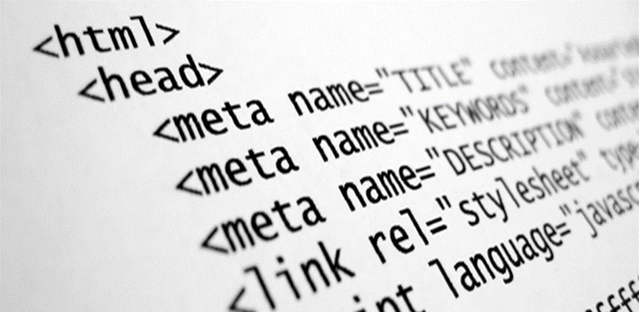

HTML – Other Tags
Semantic Tags, Frames, Embed Multimedia Content, Others
Svetlin Nakov
Technical Trainer
www.nakov.com
Software University
http://softuni.bg

Slide 2
Table of Contents
Semantic HTML
Headers, Footers, Sidebars, …
Frames
Frameset, Frame, IFrame
Multimedia Content
Audio, Video, Embedded Objects
Other Tags
<audio>
<section>
<iframe>
<svg>
<video>
<canvas>
<header>
<article>
<nav>
<meter>
<footer>
<progress>
<embed>

Slide 3
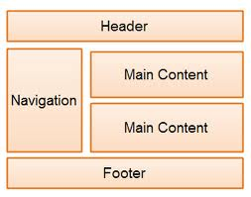
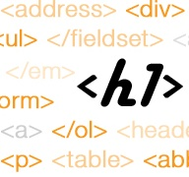
Semantic HTML

Slide 4

Semantic HTML
Semantic HTML is:
HTML markup used to reinforce the semantics in Web pages
Make the content understandable for computers
Rather than merely to define its presentation
A kind of metadata about the HTML content
Semantic HTML is processed by the Web browsers and other user agents
CSS is used to define its visual presentation to human users

Slide 5

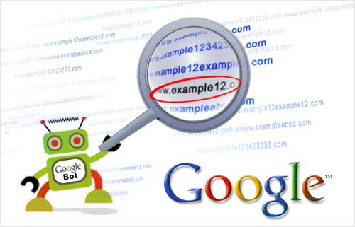
Why Use Semantic HTML?
Semantic HTML is:
Easier to read by developers
Easier to render by browsers
A way to present to the search engines the correct content

Slide 6

How To Write Semantic HTML?
Just follow some guidelines when creating a Web site
Use HTML5 semantic tags
<header>, <nav>, <section>, <article>, <aside>, <footer>
Use Headings when you need to structure the content into sub-headings
In increasing order: <h1>, <h2>, <h3>, …
Do not use empty tags
Like a clearing <div>s

Slide 7

HTML5 Semantic Tags

Slide 8
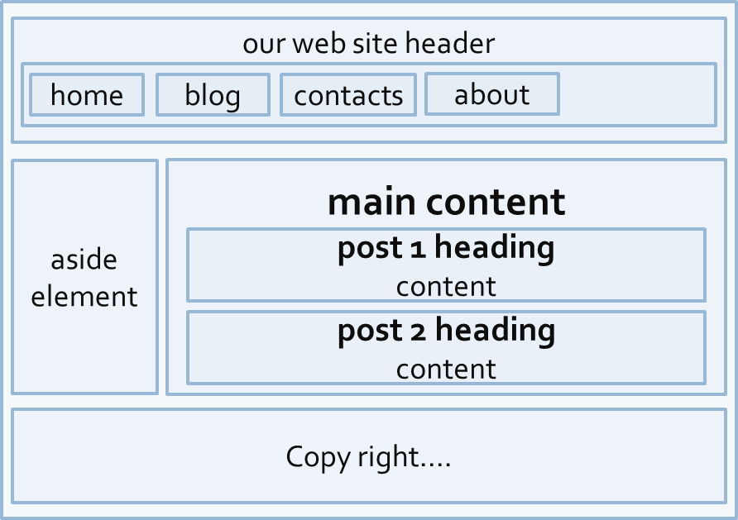
HTML5 Semantic Tags
Imagine the following site:
This is a common Web page structure
Used in the most Web sites in Internet

Slide 9
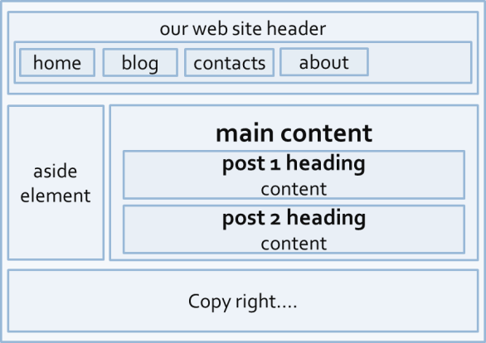
HTML5 Semantic Tags (2)
It can be created using all kind of HTML elements
<div>, <span>, even <p>
Browsers will render invalid / wrong / pseudo valid HTML
The correct way: use the HTML 5 semantic tags:
More about the semantic tags: http://pavelkolev.com/html5-snippets/.
<header> … </header>
<section> … </section>
<aside> … </aside>
<footer> … </footer>

Slide 10
HTML5 Semantic Tags (3)
<header>
Site header / section header / article header
<footer>
Site footer (sometime can be a section footer / article footer)
<main>
The site's main content (holds the main area of the content)
<nav>
Site navigation (usually used in the header)
<section>
Site section (e.g. news section, comments section, links section, …)

Slide 11
HTML5 Semantic Tags (4)
<article>
Article in a section (e.g. news item in a news section)
<aside>
Sidebar (usually on the left or on the right of the site)
<figure> + <figcaption>
Figure (a figure, e.g. inside an article) + its caption
<details> + <summary>
Accordion-like widget (can be open / closed)

Slide 12
HTML5 Semantic Tags (5)
<hgroup>
Groups article heading + sub-heading (e.g. <h1> + <h2>)
<address>
Semantically denotes an address (e.g. in the contacts page)
<time>
Specifies date / time (for a post / article / news)
<audio> / <video>
Audio / video element (uses the built-in media player)

Slide 13
HTML5 Semantic Tags (6)
<cite>, <blockquote>, <q>, <dfn>, <abbr>
Citation / quotation / quoted text / definition / abbreviation
Usually displayed in italic
<code>, <kbd>, <samp>, <var>
Source code (e.g. JavaScript code, no syntax highlighting); sample input / output result from a program; variable in the code
<ins>, <del>, <mark>
Denote inserted / deleted / highlighted text in a document
Old browsers (like IE6)? → use Modernizr or HTML5shiv

Slide 14
Other Semantics
Headings
Always use headings (<h1> – <h6>) for headings and titles
Like in a MS Word document (Heading 1, Heading 2, …)
Google uses it to find the important content
Strong <strong> vs. bold <b>
<b> does not mean anything, just makes the text bolder
<strong> marks the text is "stronger" than the other, surrounding text → more important text

Slide 15
Other Semantics (2)
Emphasis <em> vs. italic <i>
Emphasis does not always mean, that the code should be italic
It could be bolder, italic and underlined
The styles for the emphasis text should be set with CSS
Small text <small> vs. smaller font defined in CSS
<small> denotes something as smaller → less important
Strikethrough <s> vs. deleted text <del>
<del> brings "deleted" semantics

Slide 16
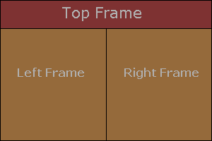
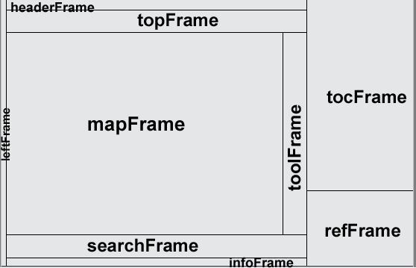
HTML Frames
<frameset>, <frame> and <iframe>

Slide 17
HTML Frames
Frames display multiple HTML documents in a single Web page
The page can be split into separate views (frames)
Horizontally and vertically, e.g. navigation and main content
Frames were popular in the early ages of HTML development
Now frames are deprecated
Avoid using frames!
Frames are not supported by all browsers
The <noframes> element provides alternative content

Slide 18
HTML Frames – Example
Using <frameset> and <frame>:
<html>
<head><title>Frames Example</title></head>
<frameset cols="180px, *, 150px">
<frame src="left.html" />
<frame src="middle.html" />
<frame src="right.html" />
</frameset>
</html>

Slide 19
Inline Frames: <iframe>
Inline frames display a website inside another website:
Inline frames can display a page inside another page
The <iframe> has fixed size (cannot adjust its size by its content)
Limited parent-child page interaction
Due to security reasons
<iframe name="iframeGoogle" width="600" height="400" src="http://www.google.com" frameborder="yes" scrolling="yes"></iframe>

Slide 20



Multimedia Context
Embedding Audio, Video and Other Media

Slide 21
Embedding Audio
The <audio> element inserts audio player in your site
Audio formats supported:
MP3, OGG, WAV (some browsers don't play all formats)
Attributes: controls, autoplay, loop, preload
<audio controls autoplay>
<source src="mysong.ogg" type="audio/ogg">
<source src="mysong.mp3" type="audio/mpeg">
Your browser does not support the &lt;audio&gt; tag.
</audio>

Slide 22
Embedding Video
The <video> element inserts video player in your site
Video formats supported: MP4, OGG, WebM (some browsers don't play all formats)
Attributes: width, height, poster, controls, autoplay, loop, preload
<video width="320" height="240" controls poster="cover.gif">
<source src="movie.mp4" type="video/mp4">
<track src="subtitles_en.vtt" kind="subtitles" srclang="en">
Your browser does not support the video tag.
</video>

Slide 23
Embedding Other Objects
Using the <embed> tag to embed Flash objects / Java applets / PDF documents / other plugin-based content
<object> is very similar tag (newer and has body content):
<embed src="calculator.swf" width="300" height="200" />
<embed src="footer.html" type="text/html" />
<object data="invoice.pdf" type="application/pdf">
<a href="invoice.pdf">Download invoice.pdf</a>
</object>

Slide 24
SVG Vector Graphics
In HTML5 you can include scalable vector graphics (SVG) through the <svg> tag:
SVG in XML based language for describing graphical objects like circles, ellipses, lines, polygons, shapes, strokes, text, etc.
<svg width="200" height="200">
<polygon points="100,10 40,180 190,60 10,60 160,180"
style="fill:lime;stroke:purple;stroke-width:5"/>
<circle cx="100" cy="93" r="20" stroke="black"
stroke-width="3" fill="red" />
Sorry, your browser does not support inline SVG.
</svg>

Slide 25
Canvas
The HTML elements <canvas> provides a field for drawing vector graphics through a JavaScript API:
<canvas id="myCanvas" width="200" height="100">Your browser does not support canvas.</canvas>
<script>
var ctx = document.getElementById("myCanvas").getContext("2d");
ctx.font = "30px Arial";
ctx.strokeText("Hello Canvas", 10, 50);
ctx.moveTo(0,0);
ctx.lineTo(200,100);
ctx.stroke();
</script>

Slide 26
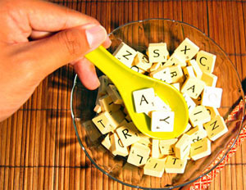
Other HTML Tags
Missing Pieces in the HTML Tag Universe

Slide 27


Progress and Meter
<progress> displays the progress of operation:
<meter> displays a progress-bar
<progress value="22" max="100"> </progress>
<meter value="2" min="0" max="10">2 out of 10</meter><br>
<meter value="0.6">60%</meter>

Slide 28
Image Maps
Images can define maps and areas to make clickable some pieces an image (rectangular / circular areas)
<img src="planets.gif" width="145" height="126"
alt="Planets" usemap="#planetmap">
<map name="planetmap">
<area shape="rect" coords="0,0,82,126" href="sun.html">
<area shape="circle" coords="90,58,3" href="mercury.html">
<area shape="circle" coords="124,58,8" href="venus.html">
</map>

Slide 29
Other Tags
<meta> – HTML document metadata
<wbr> – optional break for long words (used in hyphenation)
<br /> – line break (like the \n in the console)
<hr /> – displays a horizontal line
<head>
<meta charset="UTF-8">
<meta name="author" content="Bay Ivan">
</head>
<p>I am Very<wbr>Long<wbr>Word<wbr> that may be broken.</p>

Slide 30

Summary
Semantic HTML
<header>, <footer>, <aside>, <nav>, <article>, <section>, <h1>, <h2>, <h3>, <time>, …
HTML frames → embed HTML inside another HTML
Multimedia Content
<audio>, <video>, <embed>, <object>
<svg>, <canvas>
Other Tags: <meter>, <progress>, <map>, …

Slide 31
HTML – Other Tags
https://softuni.bg/courses/web-fundamentals/

Slide 32
License
This course (slides, examples, demos, videos, homework, etc.) is licensed under the "Creative Commons Attribution-NonCommercial-ShareAlike 4.0 International" license
Attribution: this work may contain portions from
"HTML Basics" course by Telerik Academy under CC-BY-NC-SA license
"CSS Styling" course by Telerik Academy under CC-BY-NC-SA license

Slide 33







SoftUni Diamond Partners

Slide 34




Free Trainings @ Software University
Software University Foundation – softuni.org
Software University – High-Quality Education, Profession and Job for Software Developers
softuni.bg
Software University @ Facebook
facebook.com/SoftwareUniversity
Software University @ YouTube
youtube.com/SoftwareUniversity
Software University Forums – forum.softuni.bg

